Slide 1
Building Reliable Workflows in Java Using DBOS
Harry Pierson
harry.pierson@dbos.dev
@devhawk.net

Slide 2


Slide 3


Slide 4
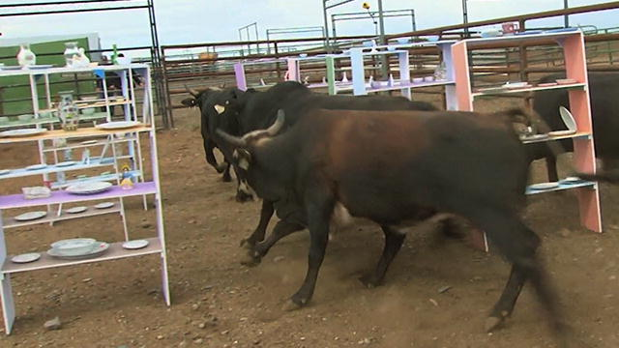


Slide 5

“Remember kids, the only difference between screwing around and science is writing it down”
Adam Savage
The same goes for reliable systems!
Notes:
https://www.youtube.com/watch?v=BSUMBBFjxrY

Slide 6
Reliable systems store
critical system state
in durable storage
so that it will survive
a system crash.
Typically, durable storage == database

Slide 7
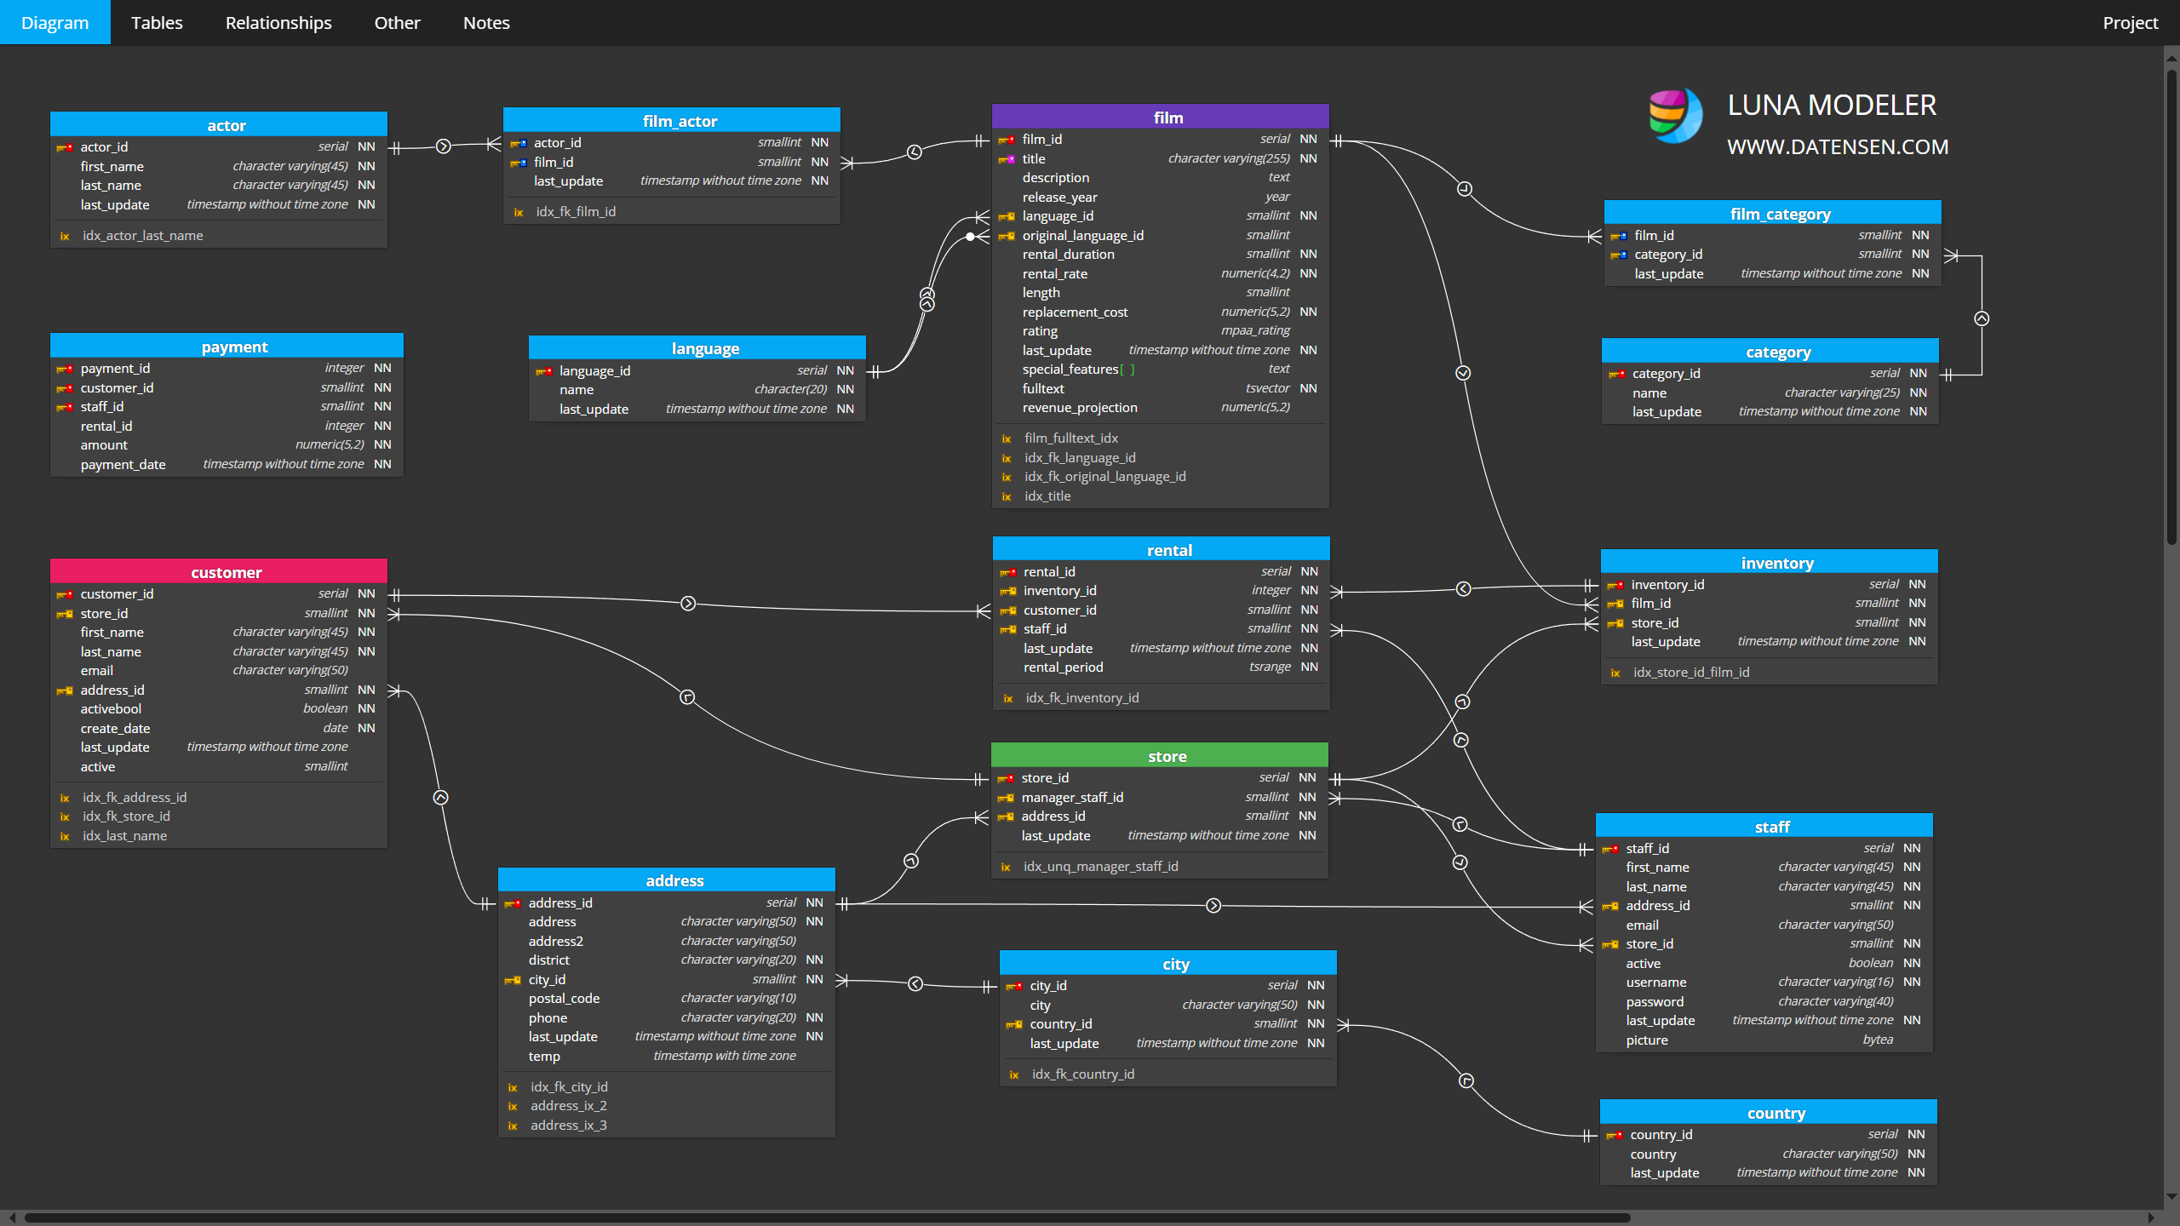
Is this all the critical system state?

Slide 8
func (cs *checkoutService) PlaceOrder(ctx context.Context, req *pb.PlaceOrderReq) (*pb.PlaceOrderResp, error) {
orderID, err := uuid.NewUUID()
if err != nil { return nil, status.Errorf(codes.Internal, "failed to generate order uuid") }
prep, err := cs.prepareOrderItemsAndShippingQuoteFromCart(ctx, req.UserId, req.UserCurrency, req.Address)
if err != nil { return nil, status.Errorf(codes.Internal, err.Error()) }
total := cs.calculateOrderTotal(req, prep)
txID, err := cs.chargeCard(ctx, &total, req.CreditCard)
if err != nil { return nil, status.Errorf(codes.Internal, "failed to charge card: %+v", err) }
shippingTrackingID, err := cs.shipOrder(ctx, req.Address, prep.cartItems)
if err != nil { return nil, status.Errorf(codes.Unavailable, "shipping error: %+v", err) }
_ = cs.emptyUserCart(ctx, req.UserId)
orderResult := cs.createOrderResult(orderID, shippingTrackingID, prep, req)
if err := cs.sendOrderConfirmation(ctx, req.Email, orderResult); err != nil {
log.Warnf("failed to send order confirmation to %q: %+v", req.Email, err)
} else {
log.Infof("order confirmation email sent to %q", req.Email)
}
resp := &pb.PlaceOrderResponse{Order: orderResult}
return resp, nil
}
https://github.com/GoogleCloudPlatform/microservices-demo

Slide 9
func (cs *checkoutService) PlaceOrder(ctx Context, req *pb.PlaceOrderRequest) (*pb.PlaceOrderResponse, error) {
orderID, err := uuid.NewUUID()
if err != nil { return nil, status.Errorf(codes.Internal, "failed to generate order uuid") }
prep, err := cs.prepareOrderItemsAndShippingQuoteFromCart(ctx, req.UserId, req.UserCurrency, req.Address)
if err != nil { return nil, status.Errorf(codes.Internal, err.Error()) }
total := cs.calculateOrderTotal(req, prep)
txID, err := cs.chargeCard(ctx, &total, req.CreditCard)
if err != nil { return nil, status.Errorf(codes.Internal, "failed to charge card: %+v", err) }
shippingTrackingID, err := cs.shipOrder(ctx, req.Address, prep.cartItems)
if err != nil { return nil, status.Errorf(codes.Unavailable, "shipping error: %+v", err) }
_ = cs.emptyUserCart(ctx, req.UserId)
orderResult := cs.createOrderResult(orderID, shippingTrackingID, prep, req)
if err := cs.sendOrderConfirmation(ctx, req.Email, orderResult); err != nil {
log.Warnf("failed to send order confirmation to %q: %+v", req.Email, err)
} else {
log.Infof("order confirmation email sent to %q", req.Email)
}
resp := &pb.PlaceOrderResponse{Order: orderResult}
return resp, nil
}
🔥
https://github.com/GoogleCloudPlatform/microservices-demo

Slide 10
Process execution state is
critical system state.
If your system doesn’t store it durably,
your system is not reliable.

Slide 11
Durable Execution 101
Checkpoint workflows and steps to durable storage.
Recover interrupted workflows from checkpoints on restart.

Slide 12
Durable Execution 101
Workflow
Durably stored before and after execution
Comprised of steps
Guaranteed to run to completion
Restarted on reboot if interrupted
Execution resumes from last completed step
Must be deterministic
Input parameters and return value must be serializable
Step
Result is durably stored after execution
Verified before execution
May be nondeterministic
Return value must be serializable

Slide 13
Durable Execution 101
WF Input
Step 1
Step 2
Durable Storage

Slide 14

Durable Execution 101
WF Input
Step 1
Step 2
🔥
Step 3
Durable Storage

Slide 15
Durable Execution 101
WF Input
Skip completed steps,
use checkpoints
Step 1
Step 2
Step 3
WF Output
Durable Storage

Slide 16
External Orchestration?
Promise: Reliable workflow execution
Reality: Complexity and Cost
  Separate infrastructure to manage
  Different programming model
  may require code changes
  Overhead of external API calls
  Vendor lock-in
Clients
(HTTP, RPC, Kafka, etc.)
Workflow Service
Workers
App Servers
Workflow Orchestration
Executors
Data Store

Slide 17
DBOS Transact
DB-backed Durable Execution Library
Why separate workflows from application logic?
  Simpler to implement and manage
Why separate workflows from entity data?
  Workflows are another type of data.
  Databases are great at handling data!
App Server
Workflow Library
Database
Your database is
all you need

Slide 18
Database Checkpoint Tables
workflow_status table
workflow_id | workflow_name | status | input | output | error
75d123-32b | exampleWorkflow | SUCCESS | {"items": …} | "Fulfilled" | <null>
6ede036e-46 | exampleWorkflow | PENDING | {"items": …} | <null> | <null>
operation_output table
workflow_id | step_id | step_name | output | error
75d123-32b | 1 | createOrderID | “26c893e1-c51e…” | <null>
75d123-32b | 2 | createOrder | "reserved" | <null>
75d123-32b | 3 | processPayment | "successful" | <null>
75d123-32b | 4 | fulfillOrder | "fulfilled" | <null>

Slide 19
Durable Execution as a Library
interface Example {
void createOrder(UUID orderId)
void exampleWorkflow()
}
class ExampleImpl implements Example {
@Step(retriesAllowed = true)
Order createOrder(UUID orderId) {
// ...
}
@Workflow
void exampleWorkflow() {
var orderId = DBOS.runStep(
() -> UUID.randomUUID(),
"createOrderId");
var order = proxy.createOrder(orderId);
// ...
}
}
Workflows and Steps are ordinary methods
Workflows are annotated and
invoked via a proxy
  Uses Java’s Proxy/InvocationHandler support
  Proxy-less invocation on the roadmap
Steps may be annotated and invoked via a proxy or wrapped in a call to DBOS.runStep.

Slide 20
Durable Execution as a Library
DBOS configured via env vars or programmatically
Workflow classes are registered with DBOS to create the dynamic proxy
Workflow methods can be invoked directly or started asynchronously
var config = DBOSConfig.defaultsFromEnv("my-app-name");
DBOS.configure(config);
var proxy = DBOS.registerWorkflows(
Example.class, new ExampleImpl());
Javalin.create(/* config */)
.events(event -> {
event.serverStarting(() -> DBOS.launch());
event.serverStopping(() -> DBOS.shutdown());
})
.get("/", ctx -> {
var handle = DBOS.startWorkflow(
() -> proxy.exampleWorkflow());
ctx.result("Hello World %s“
.formatted(handle.workflowId()));
})
.start(8080);

Slide 21
@Workflow
public String checkoutWorkflow(String key) {
var orderId = proxy.createOrder();
try {
proxy.subtractInventory();
} catch (RuntimeException e) {
logger.error("Failed to reserve inventory for order {}", orderId);
proxy.errorOrder(orderId);
DBOS.setEvent(PAYMENT_ID, null);
}
DBOS.setEvent(PAYMENT_ID, key);
var payment_status = (String) DBOS.recv(PAYMENT_STATUS, Duration.ofSeconds(60));
if (payment_status != null && payment_status.equals("paid")) {
logger.info("Payment successful for order {}", orderId);
proxy.markOrderPaid(orderId);
DBOS.startWorkflow(() -> proxy.dispatchOrderWorkflow(orderId));
} else {
logger.info("Payment failed for order {}", orderId);
proxy.errorOrder(orderId));
proxy.undoSubtractInventory();
}
DBOS.setEvent(ORDER_ID, String.valueOf(orderId));
return key;
}
https://github.com/dbos-inc/dbos-demo-apps/tree/main/java/widget-store

Slide 22
@Step
public Integer createOrder() {
return dsl.insertInto(ORDERS)
.set(ORDERS.ORDER_STATUS, OrderStatus.PENDING.getValue())
.set(ORDERS.PRODUCT_ID, PRODUCT_ID)
.set(ORDERS.LAST_UPDATE_TIME, LocalDateTime.now())
.set(ORDERS.PROGRESS_REMAINING, 10)
.returningResult(ORDERS.ORDER_ID)
.fetchOne()
.get(ORDERS.ORDER_ID);
}
Transaction Steps
are on the roadmap
https://github.com/dbos-inc/dbos-demo-apps/tree/main/java/widget-store

Slide 23
@Workflow
public String checkoutWorkflow(String key) {
var orderId = DBOS.runStep(() -> createOrder(), "createOrder");
try {
DBOS.runStep(() -> subtractInventory(), "subtractInventory");
} catch (RuntimeException e) {
logger.error("Failed to reserve inventory for order {}", orderId);
DBOS.runStep(() -> errorOrder(orderId), "errorOrder");
DBOS.setEvent(PAYMENT_ID, null);
}
DBOS.setEvent(PAYMENT_ID, key);
var payment_status = (String) DBOS.recv(PAYMENT_STATUS, Duration.ofSeconds(60));
if (payment_status != null && payment_status.equals("paid")) {
logger.info("Payment successful for order {}", orderId);
DBOS.runStep(() -> markOrderPaid(orderId), "markOrderPaid");
DBOS.startWorkflow(() -> proxy.dispatchOrderWorkflow(orderId));
} else {
logger.info("Payment failed for order {}", orderId);
DBOS.runStep(() -> errorOrder(orderId), "errorOrder");
DBOS.runStep(() -> undoSubtractInventory(), "undoSubtractInventory");
}
DBOS.setEvent(ORDER_ID, String.valueOf(orderId));
return key;
}
https://github.com/dbos-inc/dbos-demo-apps/tree/main/java/widget-store

Slide 24
@Workflow
public String checkoutWorkflow(String key) {
var orderId = DBOS.runStep(() -> createOrder(), "createOrder");
try {
DBOS.runStep(() -> subtractInventory(), "subtractInventory");
} catch (RuntimeException e) {
logger.error("Failed to reserve inventory for order {}", orderId);
DBOS.runStep(() -> errorOrder(orderId), "errorOrder");
DBOS.setEvent(PAYMENT_ID, null);
}
DBOS.setEvent(PAYMENT_ID, key);
var payment_status = (String) DBOS.recv(PAYMENT_STATUS, Duration.ofSeconds(60));
if (payment_status != null && payment_status.equals("paid")) {
logger.info("Payment successful for order {}", orderId);
DBOS.runStep(() -> markOrderPaid(orderId), "markOrderPaid");
DBOS.startWorkflow(() -> proxy.dispatchOrderWorkflow(orderId));
} else {
logger.info("Payment failed for order {}", orderId);
DBOS.runStep(() -> errorOrder(orderId), "errorOrder");
DBOS.runStep(() -> undoSubtractInventory(), "undoSubtractInventory");
}
DBOS.setEvent(ORDER_ID, String.valueOf(orderId));
return key;
}
https://github.com/dbos-inc/dbos-demo-apps/tree/main/java/widget-store

Slide 25
@Workflow
public String checkoutWorkflow(String key) {
var orderId = DBOS.runStep(() -> createOrder(), "createOrder");
try {
DBOS.runStep(() -> subtractInventory(), "subtractInventory");
} catch (RuntimeException e) {
logger.error("Failed to reserve inventory for order {}", orderId);
DBOS.runStep(() -> errorOrder(orderId), "errorOrder");
DBOS.setEvent(PAYMENT_ID, null);
}
DBOS.setEvent(PAYMENT_ID, key);
var payment_status = (String) DBOS.recv(PAYMENT_STATUS, Duration.ofSeconds(60));
if (payment_status != null && payment_status.equals("paid")) {
logger.info("Payment successful for order {}", orderId);
DBOS.runStep(() -> markOrderPaid(orderId), "markOrderPaid");
DBOS.startWorkflow(() -> proxy.dispatchOrderWorkflow(orderId));
} else {
logger.info("Payment failed for order {}", orderId);
DBOS.runStep(() -> errorOrder(orderId), "errorOrder");
DBOS.runStep(() -> undoSubtractInventory(), "undoSubtractInventory");
}
DBOS.setEvent(ORDER_ID, String.valueOf(orderId));
return key;
}
No saga needed
https://github.com/dbos-inc/dbos-demo-apps/tree/main/java/widget-store

Slide 26
Durable Execution Library Advantages
Easy to integrate into existing applications without large rewrite
Runs in-process
Separate app servers/workflow executors not required
Minimal Performance Overhead
  2 database writes per workflow
  1 database write per step
Mature architecture
  Stateless app server(s) + stateful database

Slide 27
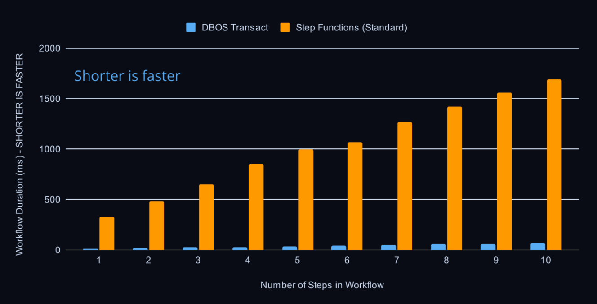
https://www.dbos.dev/blog/dbos-vs-aws-step-functions-benchmark

Slide 28
Additional DBOS Features
Workflow Communication
Integrated Queues
Scheduled Workflows (aka Durable cron)
Workflow Management
Cloud Console

Slide 29
Workflow Communication
@Workflow
public String checkoutWorkflow(String key) {
var orderId = DBOS.runStep(() -> createOrder(), "createOrder");
try {
DBOS.runStep(() -> subtractInventory(), "subtractInventory");
} catch (RuntimeException e) {
logger.error("Failed to reserve inventory for order {}", orderId);
DBOS.runStep(() -> errorOrder(orderId), "errorOrder");
DBOS.setEvent(PAYMENT_ID, null);
}
DBOS.setEvent(PAYMENT_ID, key);
var payment_status = (String) DBOS.recv(PAYMENT_STATUS, Duration.ofSeconds(60));
if (payment_status != null && payment_status.equals("paid")) {
logger.info("Payment successful for order {}", orderId);
DBOS.runStep(() -> markOrderPaid(orderId), "markOrderPaid");
DBOS.startWorkflow(() -> proxy.dispatchOrderWorkflow(orderId));
} else {
logger.info("Payment failed for order {}", orderId);
DBOS.runStep(() -> errorOrder(orderId), "errorOrder");
DBOS.runStep(() -> undoSubtractInventory(), "undoSubtractInventory");
}
DBOS.setEvent(ORDER_ID, String.valueOf(orderId));
return key;
}
https://github.com/dbos-inc/dbos-demo-apps/tree/main/java/widget-store

Slide 30
Workflow Communication
@PostMapping("/checkout/{key}")
public ResponseEntity<String> checkout(@PathVariable String key) {
var options = new StartWorkflowOptions(key);
DBOS.startWorkflow(() -> widgetStoreService.checkoutWorkflow(key), options);
String paymentID = (String) DBOS.getEvent(key, PAYMENT_ID, Duration.ofSeconds(60));
if (paymentID == null) {
return ResponseEntity.internalServerError().body("Item not available");
}
return ResponseEntity.ok(paymentID);
}
@PostMapping("/payment_webhook/{key}/{status}")
public ResponseEntity<String> payment(@PathVariable String key, @PathVariable String status) {
DBOS.send(key, status, PAYMENT_STATUS);
String orderId = (String) DBOS.getEvent(key, ORDER_ID, Duration.ofSeconds(60));
return ResponseEntity.ok(orderId);
}
https://github.com/dbos-inc/dbos-demo-apps/tree/main/java/widget-store

Slide 31
Integrated Queues
var queue = new Queue("my-queue")
.withConcurrency(10)
.withWorkerConcurrency(10)
.withRateLimit(5, Duration.ofSeconds(1))
.withPriorityEnabled(true)
.withPriorityEnabled(true)
.withPartitionedEnabled(true);
DBOS.registerQueue(queue);
var options = new StartWorkflowOptions(queue)
.withPriority(2)
.withDeduplicationId("dedupe-id") // Note: can’t use dedupe ID
.withQueuePartitionKey("some-key"); // and partition key together
var handle = DBOS.startWorkflow(() -> proxy.workflow(), options);
https://github.com/dbos-inc/dbos-demo-apps/tree/main/java/widget-store

Slide 32
Queue Tables
workflow_status table
workflow_id | workflow_name | status | input | output | error
75d123-32b | exampleWorkflow | SUCCESS | {"items": …} | "Fulfilled" | <null>
6ede036e-46 | exampleWorkflow | PENDING | {"items": …} | <null> | <null>
Hey! This is just the
workflow checkpoint table!

Slide 33
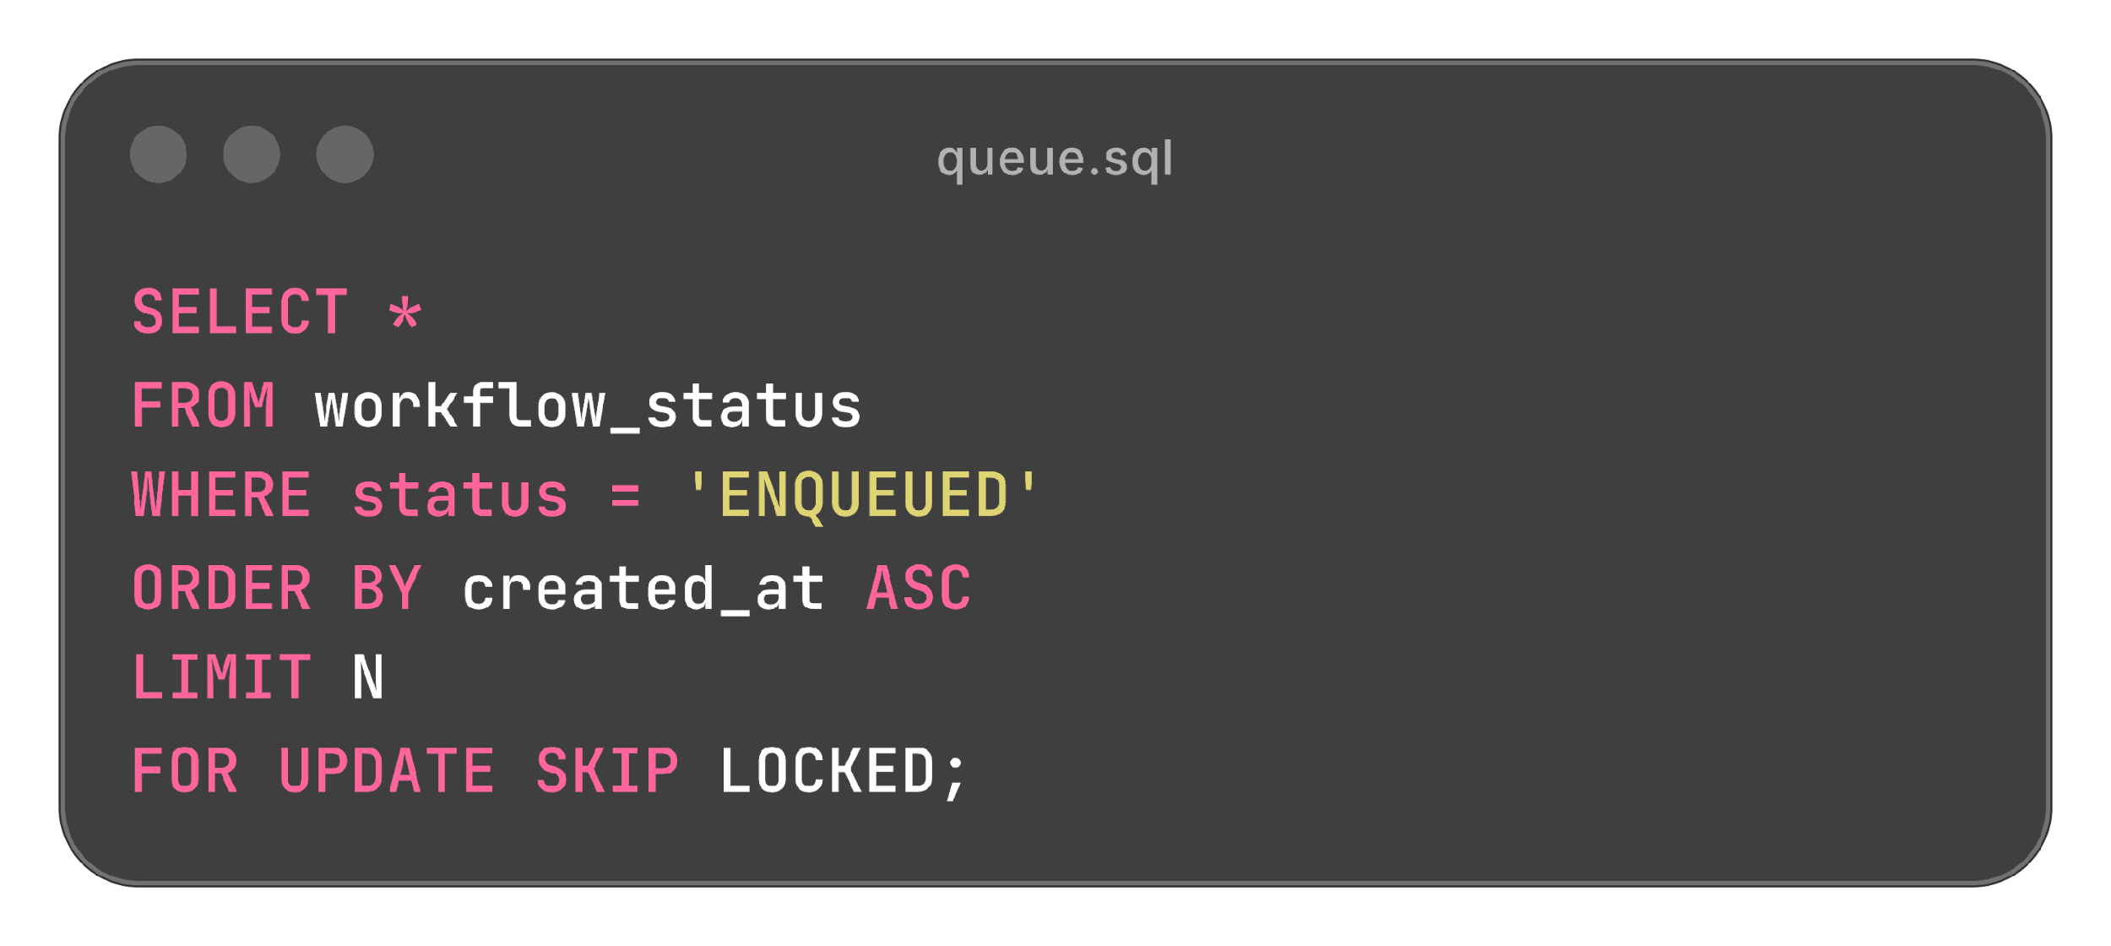
Queue Tables via Locking Clauses

Slide 34
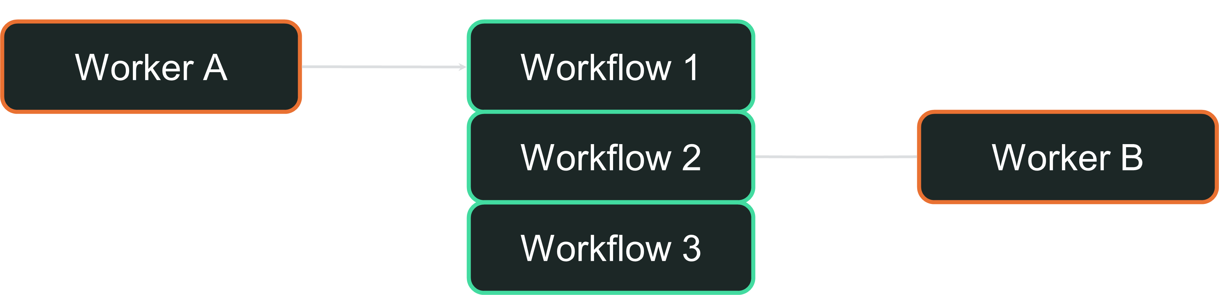
Queue Tables via Locking Clauses
Each Worker selects rows that are not already locked

Slide 35
Scheduled Workflows (aka Durable Cron)
@Workflow
@Scheduled(cron = "0/1 * * * * *", ignoreMissed = true)
public void everySecondIgnoreMissed(Instant scheduled, Instant actual) {
// ...
}
https://github.com/dbos-inc/dbos-demo-apps/tree/main/java/widget-store

Slide 36

Workflow Management
Workflow Management via SQL Queries
List, Search, Cancel, Resume *AND* Fork

Slide 37

Sometimes Things Go Wrong…

Slide 38
Fixing Bugs with Fork
Restart a workflow from a specific step
Copy old inputs/outputs (up to the specified step) to a new workflow
Replay execution with the new workflow

Slide 39
Fixing Bugs with Fork
Workflow ID: V1
Step 1
🐛
Step 2 has bug that caused
Step 3 to fail
Step 2
🔥
Step 3

Slide 40
Fixing Bugs with Fork
Workflow ID: V1
Fork from Step 2
Step 1
Step 1
Create new workflow ID
Copy Workflow input +
Step 1 output
Resume Execution from
fixed Step 2
🐛
Step 2
Step 2 - Fixed
🔥
Step 3

Slide 41
Fixing Bugs with Fork
Workflow ID: V1
Workflow ID: V1-fixed
Fork from Step 2
Step 1
Step 1
🐛
😊
Step 2
Recovered from Failure!
Step 2 - Fixed
😊
🔥
Step 3
Step 3

Slide 42
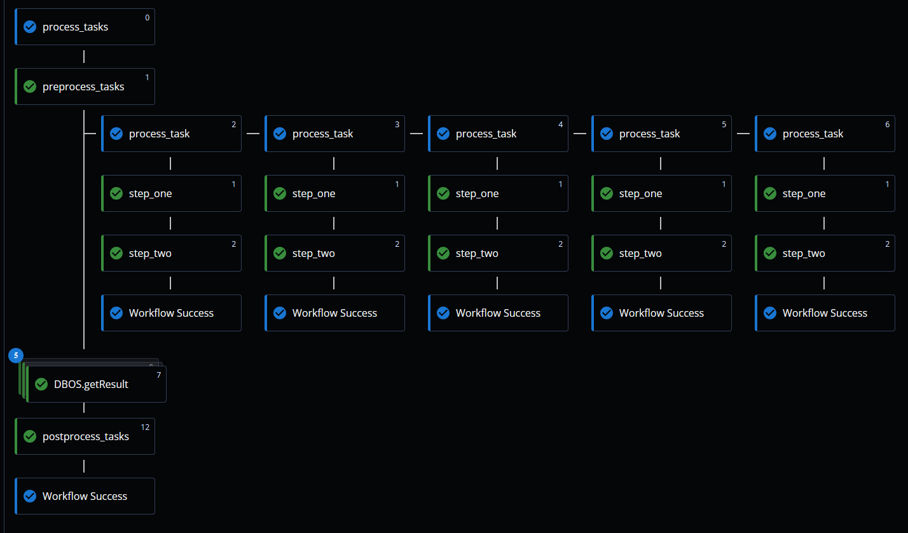
Cloud Console

Slide 43
Demo

Slide 44
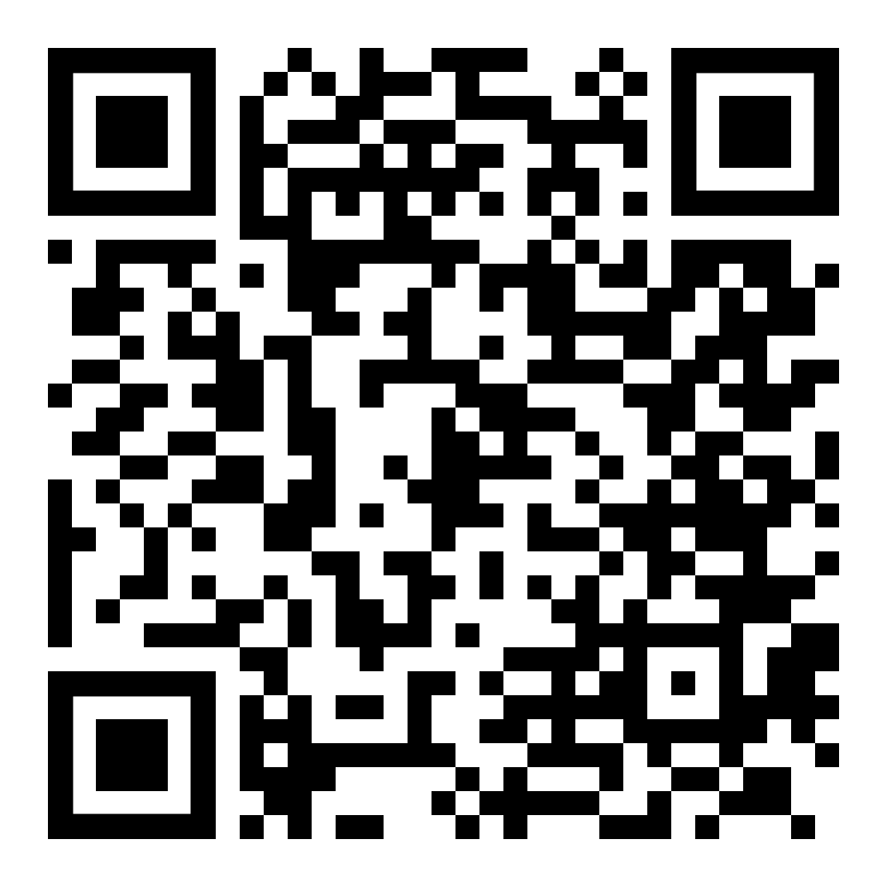
“Remember engineers, the only difference between screwing around and building a reliable system is durable execution with DBOS.”
- Harry Pierson
harry.pierson@dbos.dev
@devhawk.net

